Slide 1
Lecture: Priority Queue

Slide 2
Quiz Sample
Is array a data structure?
What is a data structure?
What data structures are implemented by array?
Priority queue (max --, min --).
No! Why?
It is a data organization associated with a set of operations
Stack, Queue, List, Heap, Max-heap, Min-heap,
…

Slide 3
Quiz Sample
Is Dial algorithm with running time O(m+nc) a polynomial-time algorithm, where c is the maximum arc length?

Slide 4
Quiz Sample
Is Dial algorithm with running time O(m+nc) a polynomial-time algorithm, where c is the maximum arc length?
Answer: No

Slide 5



Implementations
With min-priority queue, Dijkstra algorithm can be
implemented in time
With Fibonacci heap, Dijkstra algorithm can be implemented
in time
With Radix heap, Dijkstra algorithm can be implemented
in time

Slide 6
Contents
Recall: Heap, a data structure
Min-heap
(a) Min-Heapify procedure
(b) Building a min-heap
Min-Priority Queue
Implementation of Dijkstra’s Algorithm

Slide 7
Heap

Slide 8
A Data Structure Heap
A heap is an array object that can be viewed as a nearly complete binary tree.
1
6
2
3
5
3
6
5
3
2
4
1
4
5
6
2
4
1
Tied with three procedures for finding
Parent, finding left child, and finding
Right child.
All levels except last
level are complete.

Slide 9
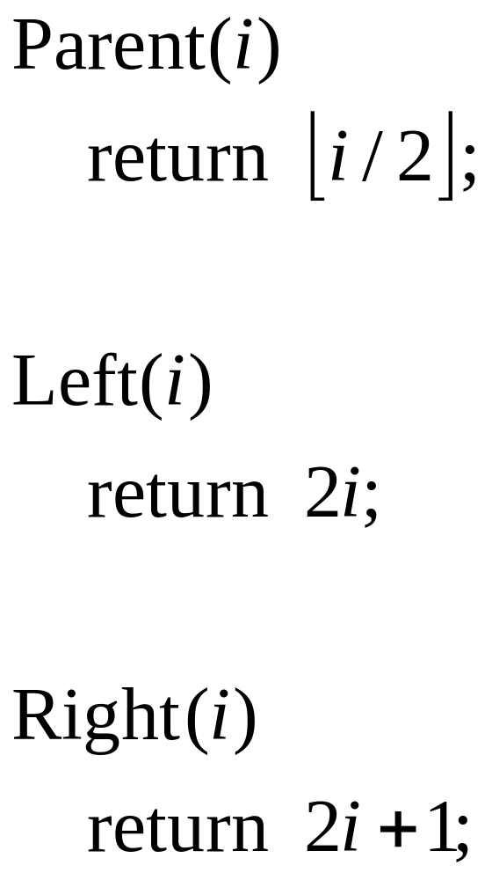

Slide 10
Min-Heap

Slide 11
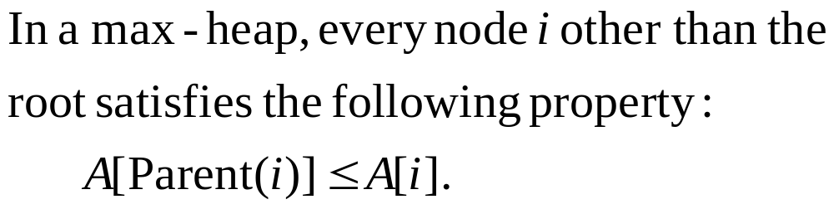
Min-Heap

Slide 12
Min-Heapify
Min-Heapify(A,i) is a subroutine.
Input: When it is called, two subtrees rooted at Left(i) and Right(i) are min-heaps, but A[i] may not satisfy the min-heap property.
Output: Min-Heapify(A,i) makes the subtree rooted at A[i] become a min-heap by letting A[i] “float down”.

Slide 13
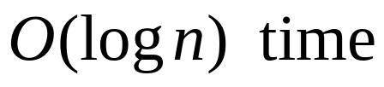
14
4
4
7
14
7
12
8
11
12
8
11
4
8
7
2
14
1

Slide 14
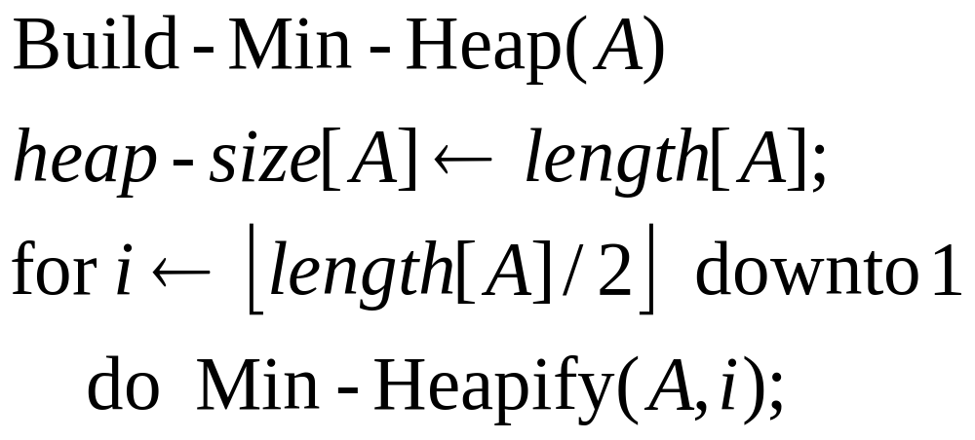
Building a Min-Heap
e.g., 4, 1, 3, 2, 16, 9, 10, 14, 8, 7.

Slide 15
4
1
3
2
16
9
10
14
8
7

Slide 16
4
1
3
2
7
9
10
14
8
16

Slide 17
4
1
3
2
7
9
10
14
8
16

Slide 18
4
1
3
2
7
9
10
14
8
16

Slide 19
4
1
3
2
7
9
10
14
8
16

Slide 20
1
4
3
2
7
9
10
14
8
16

Slide 21
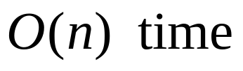
1
2
3
4
7
9
10
14
8
16

Slide 22
Priority Queue

Slide 23
Priority Queue
A priority queue is a data structure for maintaining a set of elements, each with an associated value, called a key.
A min-priority queue supports the following operations: Minimum(S), Extract-Min(S), Increase-Key(S,x,k), Insert(S,x).
Min-Heap can be used for implementing
min-priority queue.

Slide 24
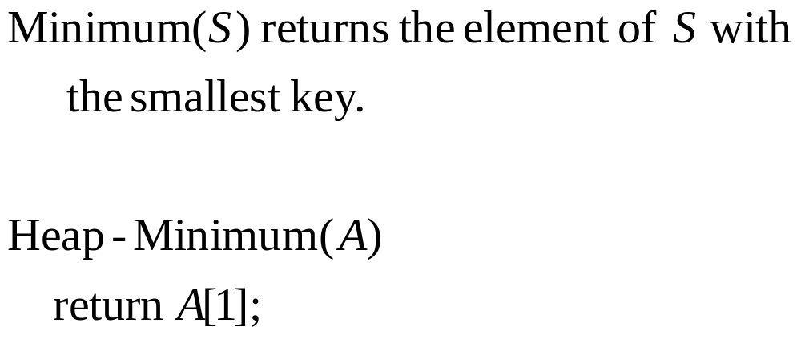

Slide 25
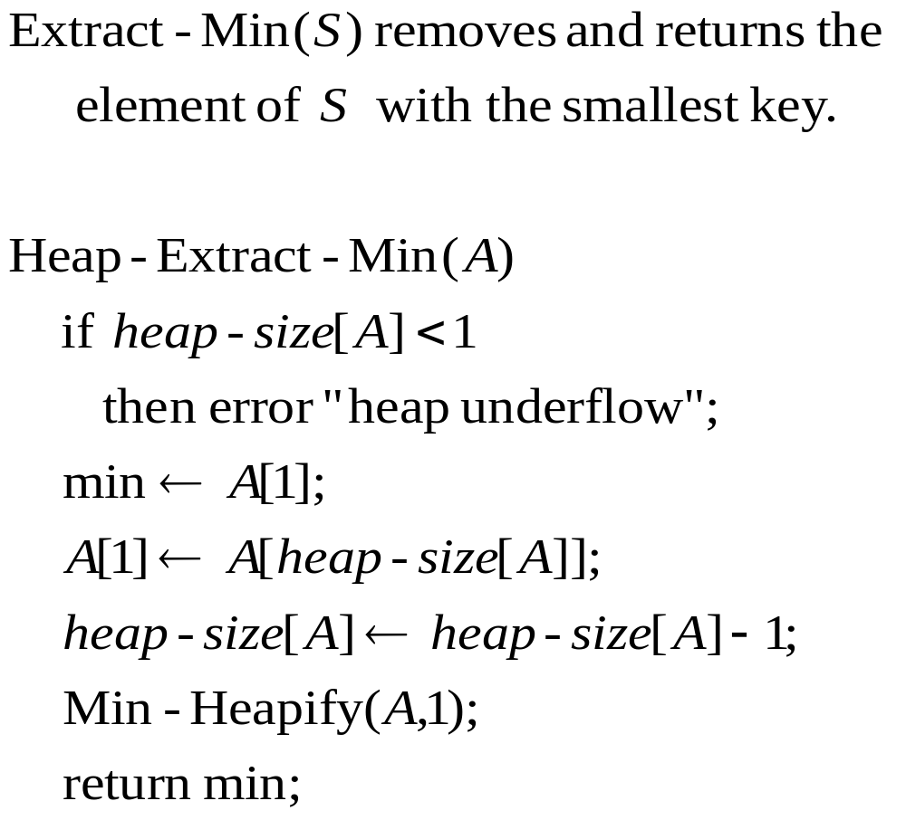

Slide 26
Input: 4, 1, 3, 2, 16, 9, 10, 14, 8, 7.
Build a min-heap
1
2
3
4
7
9
10
14
8
16
1, 2, 3, 4, 7, 9, 10, 14, 8, 16.

Slide 27

16
2
3
4
7
9
10
14
8
16, 2, 3, 4, 7, 9, 10, 14, 8.

Slide 28
2
16
3
4
7
9
10
14
8
2, 16, 3, 4, 7, 9, 10, 14, 8.

Slide 29
2
4
3
7
9
10
16
14
8
2, 4, 3, 16, 7, 9, 10, 14, 8.

Slide 30
2
4
3
8
7
9
10
14
16
2, 4, 3, 8, 7, 9, 10, 14, 16.

Slide 31
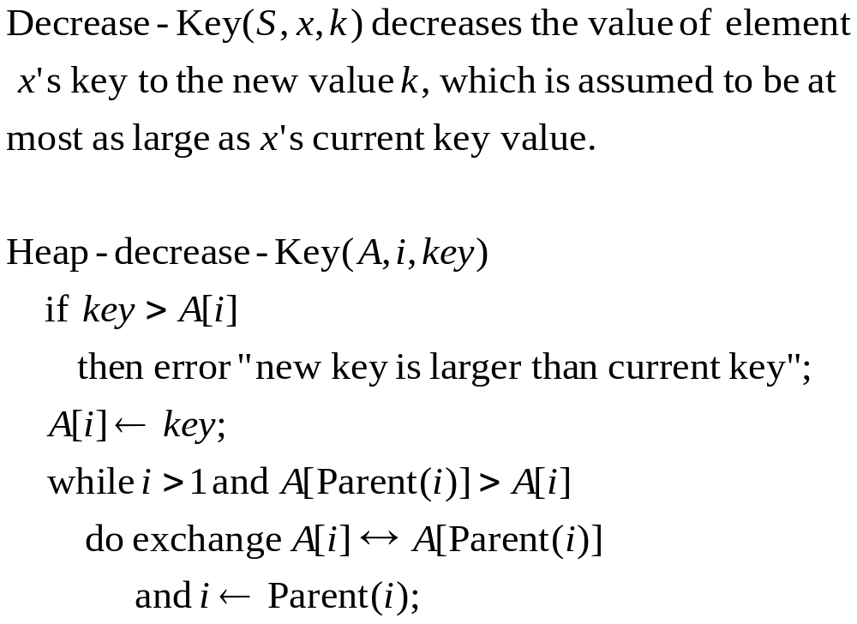
Element = address i

Slide 32
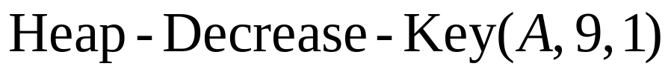
1
2
3
4
7
9
10
14
8
16
1, 2, 3, 4, 7, 9, 10, 14, 8, 16.

Slide 33
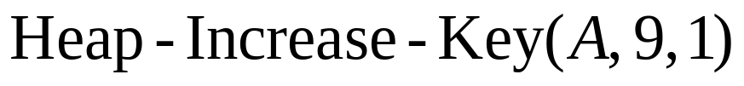
1
2
3
4
7
9
10
14
1
16
1, 2, 3, 4, 7, 9, 10, 14, 1, 16.

Slide 34
1
2
3
1
7
9
10
14
4
16
1, 2, 3, 1, 7, 9, 10, 14, 4, 16.

Slide 35
1
1
3
2
7
9
10
14
4
16
1, 1, 3, 2, 7, 9, 10, 14, 4, 16.

Slide 36
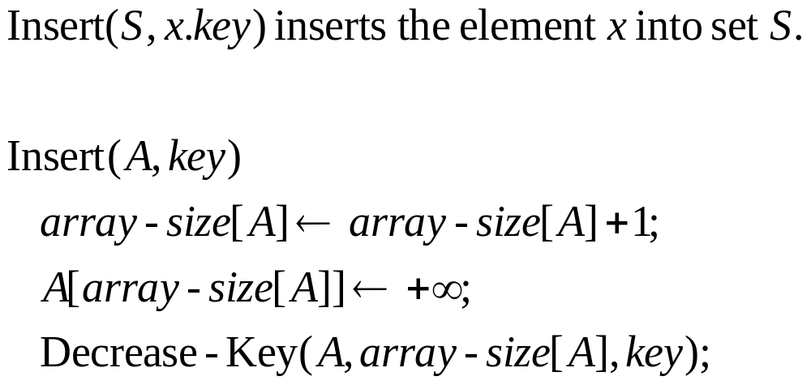
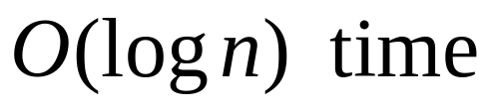

Slide 37
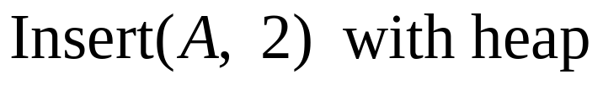
1
3
6
4
7
9
10
14
8
16
1, 3, 6, 4, 7, 9, 10, 14, 8, 16.

Slide 38
1
3
6
4
7
9
10
14
8
16
+∞
1, 3, 6, 4, 7, 9, 10, 14, 8, 16, +∞.

Slide 39
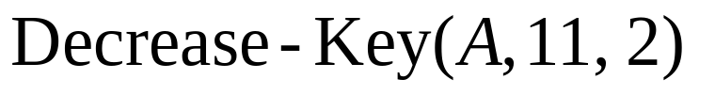
1
3
6
4
7
9
10
14
8
16
2
1, 3, 6, 4, 7, 9, 10, 14, 8, 16, 2.

Slide 40
1
2
6
4
3
9
10
14
8
16
7
1, 2, 6, 4, 3, 9, 10, 14, 8, 16, 7.

Slide 41
Implementation of Dijkstra’s Algorithm

Slide 42
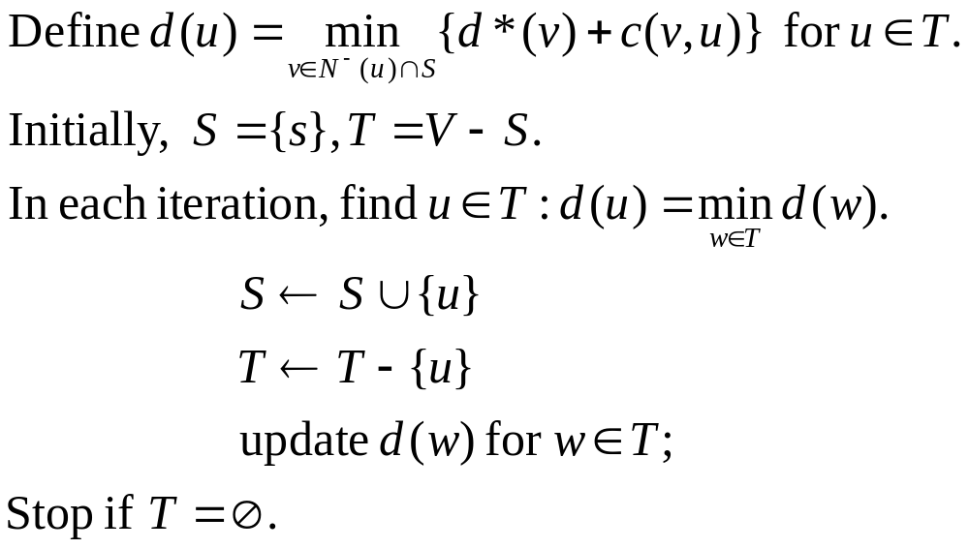
Dijkstra’s Algorithm

Slide 43
Implementations
With min-priority queue, Dijkstra algorithm can be
implemented in time
With Fibonacci heap, Dijkstra algorithm can be implemented
in time
With Radix heap, Dijkstra algorithm can be implemented
in time

Slide 44
Thanks, end.

